Slide 1
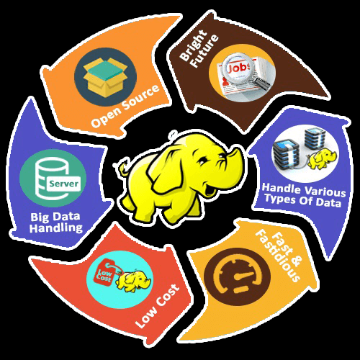
Bigdata & Hadoop
by
Vasu

Slide 2
Overview
What is Bigdata ?

Slide 3
Bigdata
BigData ………………. is a concept or term.
BigData ……………… is not a technology. .
BigData ……………… is all about the ability of the software or Technique to handle the
large dataset of varied structure and complex nature
BigData ………………. Big Data is a collection of different hardware and software
technologies, which have heterogeneous infrastructure
BigData ……………… is a Problem statement (5 Vs)
Bigdata ………………. The term BigData was initially coined by Charles Tilly

Slide 4
Overview
What is Hadoop & Why Hadoop ?

Slide 5
What is Hadoop ?
Hadoop is a frame work (Java)
Hadoop components are HDFS (Storage) & MapReduce (Process)
Hadoop is a processing-engine (batch)
Hadoop USP is Horizontal scalability and Distributed Computation
Hadoop is a open source software from Apache Software Foundation (2006)

Slide 6
Evolution
File System
Database System
Hadoop Distributed File System (HDFS)

Slide 7
Necessity of Hadoop
Smart Phone
Social Media
IoT
YouTube
Web logs
Sensor Signals
Videos/Images

Slide 8
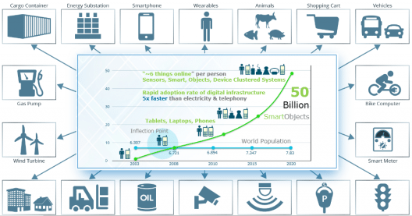

Slide 9
Characteristics of BigData 5 V’ s
Velocity
Flow or Speed of data is massive and continuous.
Batch, Periodic, Near Real-Time and Real-time
Social Media, Mobile devices, Streaming data
Volume
Size of the data
Human generated , Machine generated
Variety
Structured
Semi-Structured
Un-Structured data
Veracity
Data abnormality bias, noise, junk
To clean “dirty data” for Data Quality
Value
Meaningful, optimizing Business Value

Slide 10
Volume
Youtube uploads 400 hours of video in every minute
Facebook generates 600 TB data daily
EBay uses more than 6 PB data daily
Social media stores 5 trillion photos stored in various devices
US Library of Congress maintains 235 TB data daily
CERN Hadron Collider generates 15 PB every year
British Telecom generates 4.5 TB data daily
New York Stock Exchange (NYSE) generates 1 TB data daily

Slide 11
Variety
Structured data - a Physical Schema - Database
Semi-Structured - No rigid schema , logical - JSON & XML
Un-structured Schema – Data with No Schema – Audio, Video, Images

Slide 12
Velocity
Twitter generates 6,00,000 Avg. tweets per minute, 60 crores/day
Google 40000 searches every second, 4 billion searches every day
Mobile device traffic 6.5 billion giga bytes
Walmart handles 1.5 million customers every one hour
Note : Natham Marz – Lambda Architecture - Near Real Time processing
– YARN, Spark v 2.0

Slide 13
Veracity
Cleaning up “Dirty data”
Data Quality
Data Re-search
Note: Elimination of noises, junks, duplicates, mathematical & predictive level analysis

Slide 14
Why Hadoop ?
Open – Source & Flexible with various Applications and platform
Process , Structured, Semi-structured & Un-structured large volume of data
High scalability and availability
Cost Effective - Uses commodity (cheap!) hardware with little redundancy
Fault-tolerance - Storage & Processing
Broader Service – MapReduce, Hive, HBase, Pig – Cloud based service (EMR)
Supports ELT to ETL
Moves computation (Appl) rather than sending the data (Sending Job Tracker to data blocks) - Computation @ Data Locality
Horizontal Scalability & Distributed Computation

Slide 15
Pre-requisite
Linux Commands
Core Java
SQL
Python

Slide 16

Hadoop History
Google File System (GFS) & MapReduce processing model was Developed by Google
Doug Cutting was working in Yahoo
2005: Doug Cutting and Michael J. Cafarella developed Hadoop to support distribution for the Nutch search engine project.
The project was funded by Yahoo.
2006: Yahoo gave the project to Apache
Software Foundation.
Doug Cutting Named the project “Hadoop” after his son’s toy elephant.
Doug Cutting is now co-founder of Cloudera
Doug Cutting

Slide 17
Hadoop History
Dec 2004 – Google GFS paper published
July 2005 – Nutch uses MapReduce
Feb 2006 – Starts as a Lucene sub-project
Apr 2007 – Yahoo ! on 1000-node cluster
Jan 2008 – An Apache Top Level Project
Jul 2008 – A 4000 node test cluster
May 2009 – Hadoop sorts Petabyte in 17 hours
2008 - Hadoop Wins Terabyte Sort Benchmark (sorted 1 terabyte of data in 209 seconds, compared to previous record of 297 seconds)
2009 - Avro and Chukwa became new members of Hadoop Framework family
2010 - Hadoop’s HBase, Hive and Pig subprojects completed, adding more computational power to Hadoop framework
2011 - ZooKeeper Completed (Distributed and dynamic configuration)
2015 - Hadoop 2.6.0 Generation II
- Ambari (cluster management), Cassandra, Mahout, Spark have been added
2017 - Hadoop version 3.0 - Dec 2017
2018 - Hadoop Version 3.0.3

Slide 18
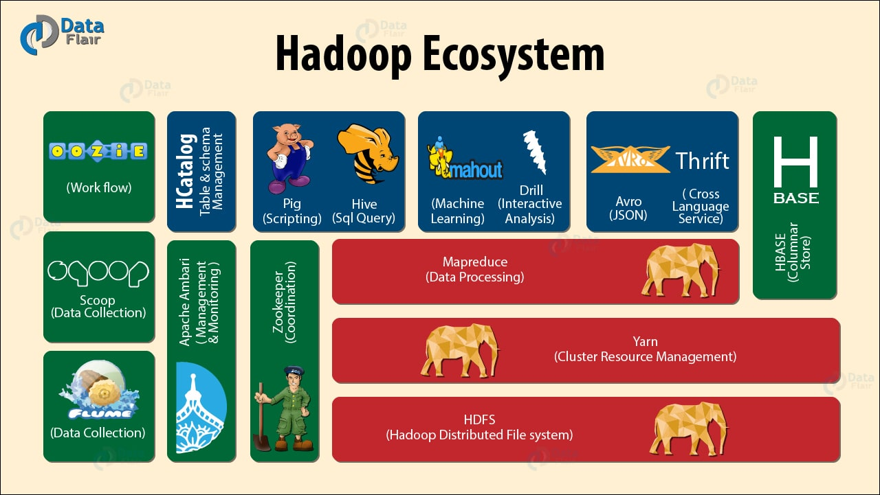
-

Slide 19
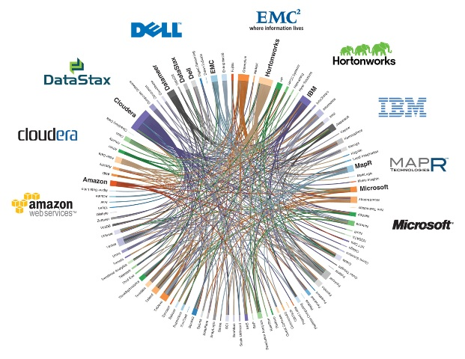
Hadoop Distributors & Certification

Slide 20
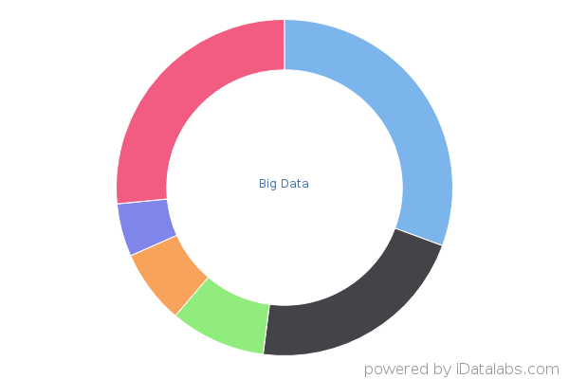
Hadoop Market Share
70,158
Companies using Big Data
Big Data
Informatica (30.61%)
Apache Hadoop (21.43%)
Teradata (9.18%)
Apache Hbase (7.14%)
MapR (5.10%)

Slide 21
Conclusion
Advantage of Hadoop
Cheaper, open source
Designed to tolerate faults
Handles structured & unstructured data
Advantage of HDFS
High scalability
High storage
Horizontal Scalability & Distributed Computation
Advantage of Map reduce programming model
Parallel programming
Process large data sets
Moving Appl computation to data
Single compute + data cluster

Slide 22


Vasu

